Slide 1
EDGAR Terminal
Alexander Arevalo, Daniel Benayoun, Jonathan M Brooks

Slide 2
Project Idea Recap
A web browser app that takes financial data from official SEC filings and makes it easily accessible to retail investors and traders
An alternative to extremely expensive and exclusive financial data systems such as a bloomberg terminal
Create a place where the common person participating in the stock market can make informed investment decisions
We use a simple approach to reading XBRL and parsing into something useful!

Slide 3
System overview
The system consists of three main parts: search for the stock by symbol; view insider holdings; and request fundamentals.
In the system, the user will enter a stock trading symbol, the symbol is resolved into CIK number, subsequent files are pulled from the SEC database using a web scraper.
The data received is then formatted to json using an XBRL parser.
A user will be able to see our stock analysis and reactive graphics showing a variety of trends including changes of company insider holdings.

Slide 4
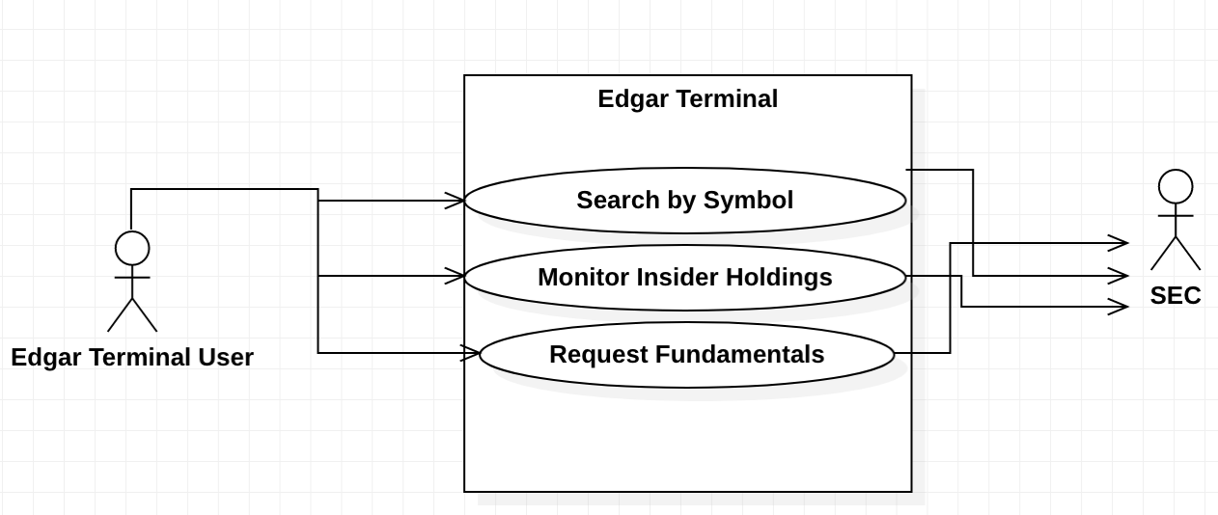
System components and diagram

Slide 5
Architectural style
3 tier architectural style
Presentation tier for the user interface
Application tier where we analyze and manipulate data
Data tier where we access data from the SEC database

Slide 6
Design patterns
Adapter
Converting XBRL from SEC database into JSON
Command
Encapsulating the command request ‘Monitor insider holdings’ and ‘request fundamentals’ as objects.

Slide 7
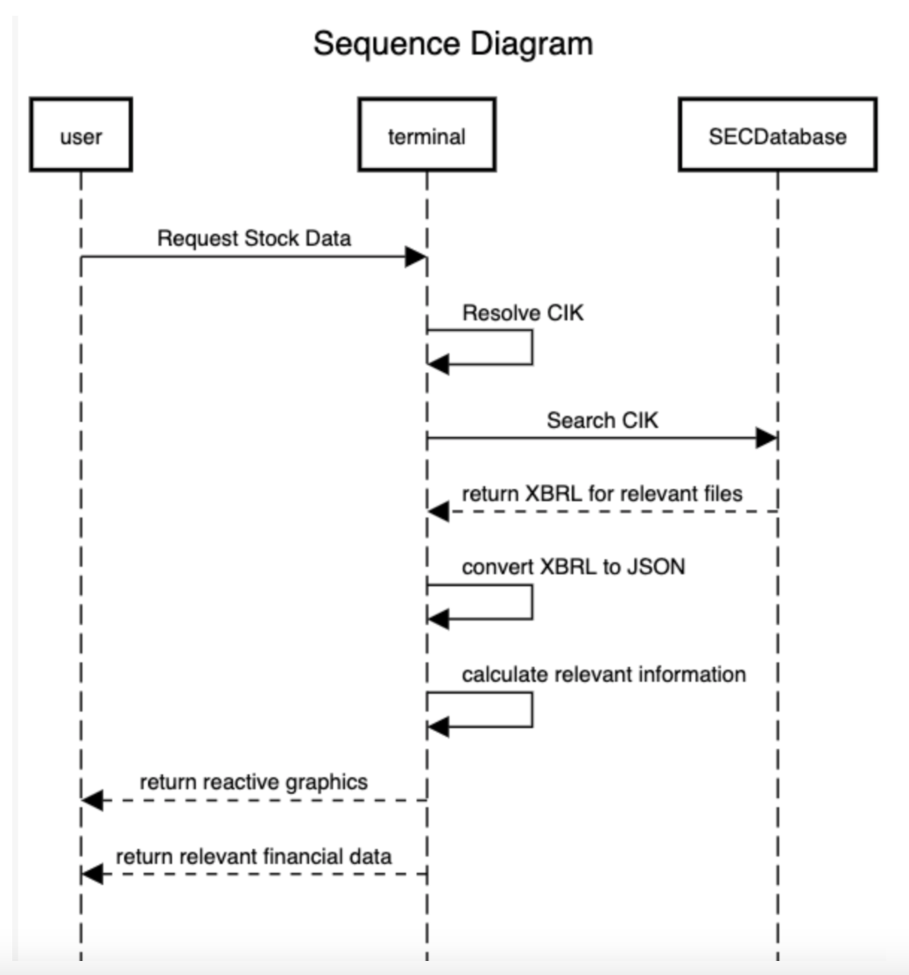
Sequence Diagram

Slide 8
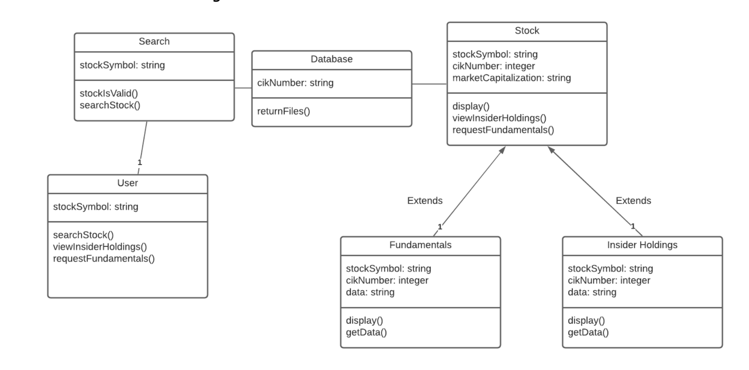
Class Diagram

Slide 9
Github Link
Visit our github!
https://github.com/dsb132/EDGAR-terminal

